Slide 1
Verification of Severe Weather: Verification of Rare & Extreme Rain Verification of Tropical Cyclone
Raghavendra Ashrit

Slide 2
Outline
Verification of Rare/Extreme Events
Extreme weather events definition.
Verification of daily rainfall over Mumbai. NCUM Day-1 forecasts (2013-2020)
Verification metrics commonly used & Issues for verification of rare/extreme events
Odds Ratio (OR), Extreme Dependence Index (EDI) & Symmetric Extremal Dependence Index (SEDI)
Summary
Severe Weather Verification
Tropical Cyclone Track
DPE, ATE and CTE
Tropical Cyclone Intensity
Summary

Slide 3
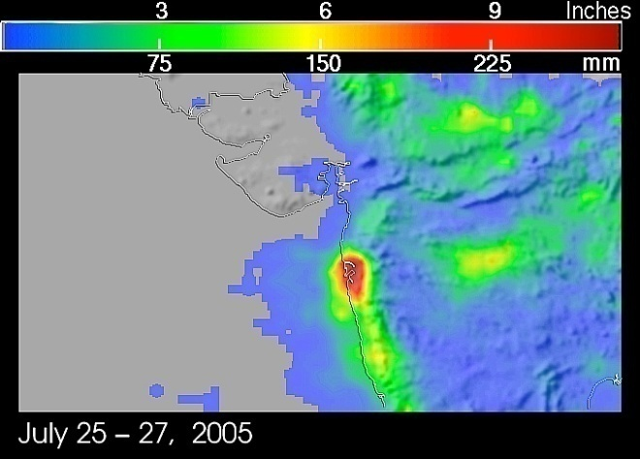
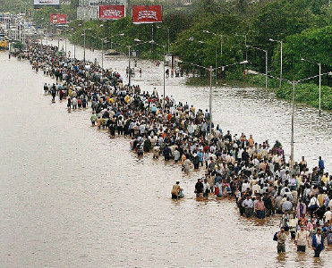
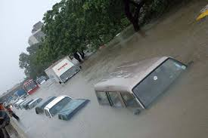
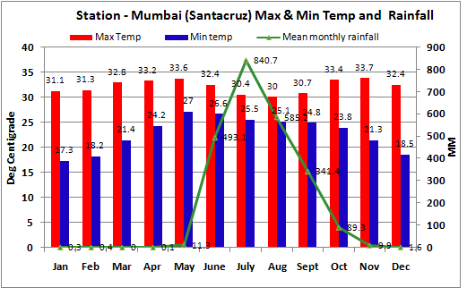
The Mumbai Deluge 27 Jul 2005
994mm in 24 hours. (03UTC26th to 03UTC 27th July 2005
Significant portion of the season total rain in one day

Slide 5
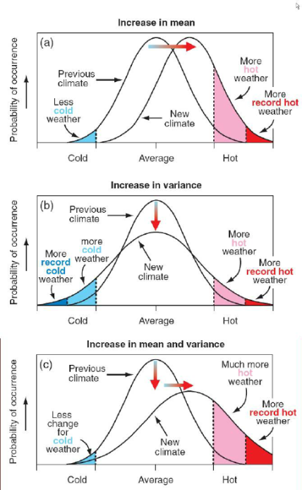
What is an extreme event?
.
A definition often used in statistics is:
extreme events are events in the tail of the distribution.
Different definitions:
Maxima/minima :
Magnitude
Rarity (frequency)
Severity (Impact)
Any number of methods could be used to establish what represents an ‘extreme’ 1 day event in the highly variable climate types existing across India
(e.g. Karl et al., 1995; Karl and Easterling, 1999; Manton et al., 2001).

Slide 6

What is an extreme event?
The WMO document
provides guidelines to define and characterize extreme weather and climate events
provide some examples that were provided through the country survey.

Slide 7
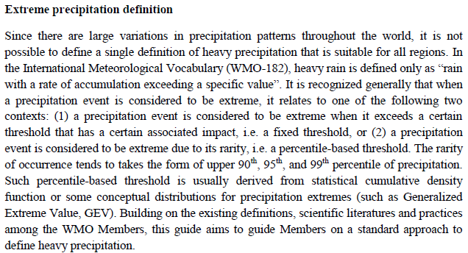
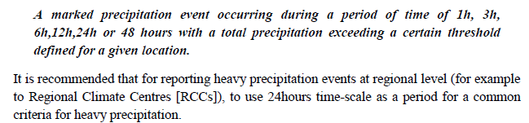
What is an extreme event?

Slide 8
What is an extreme event?
They are severe: Extreme events bring severe impacts to life and property (socio-economic)
They are rare: Unexpected and unprepared/underprepared to cope/manage the impacts.
Need Forecasts: NWP Models with high spatial and temporal resolution predict severe weather (heavy rains, intense storms, Cyclones etc.,) & are expected to predict the extreme events and severe impacts.
They are changing: 20th Century extreme rain trends in India
They will change: Climate Change projections indicate increase in the frequency and intensity of extreme events

Slide 9
Challanges
Observational Data: High resolution, quality controlled observational data.
Sample Size: Since the events are rare, small samples lead to uncertainty. Data pooling in space & time can introduce inhomogeneities.
Extremes are often characterized by large values (and outliers): robust and resistant statistics are necessary for their treatment.
Verification Scores degenerate to trivial values as the events become rare.

Slide 10
2013-2020

Slide 11
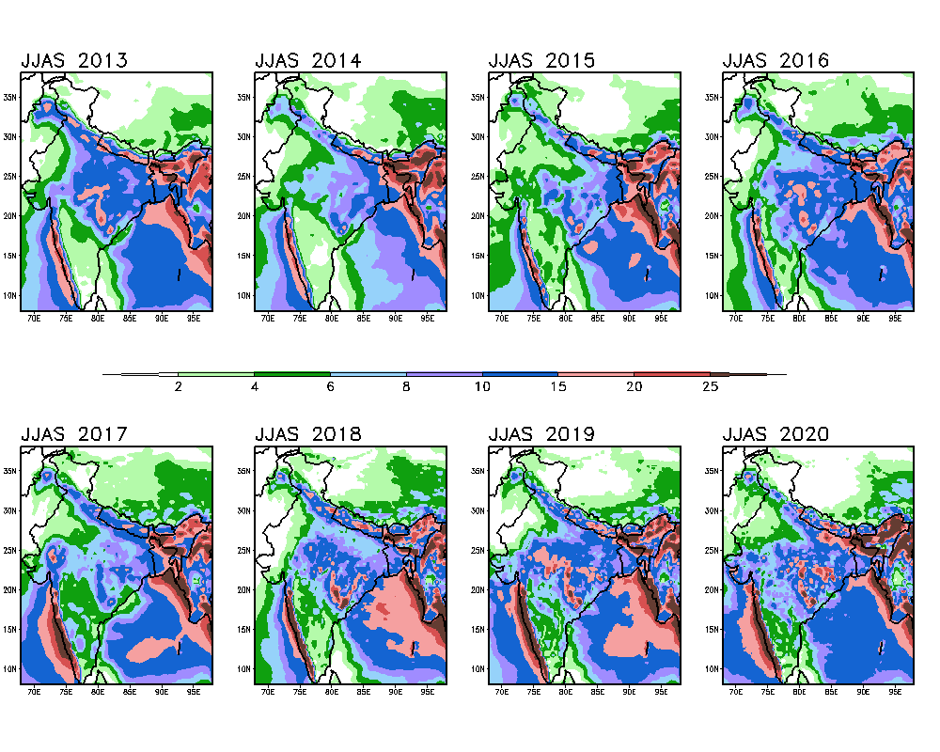
NCUM Day-1 Forecasts Mean JJAS Rainfall (mm/day) over India

Slide 12
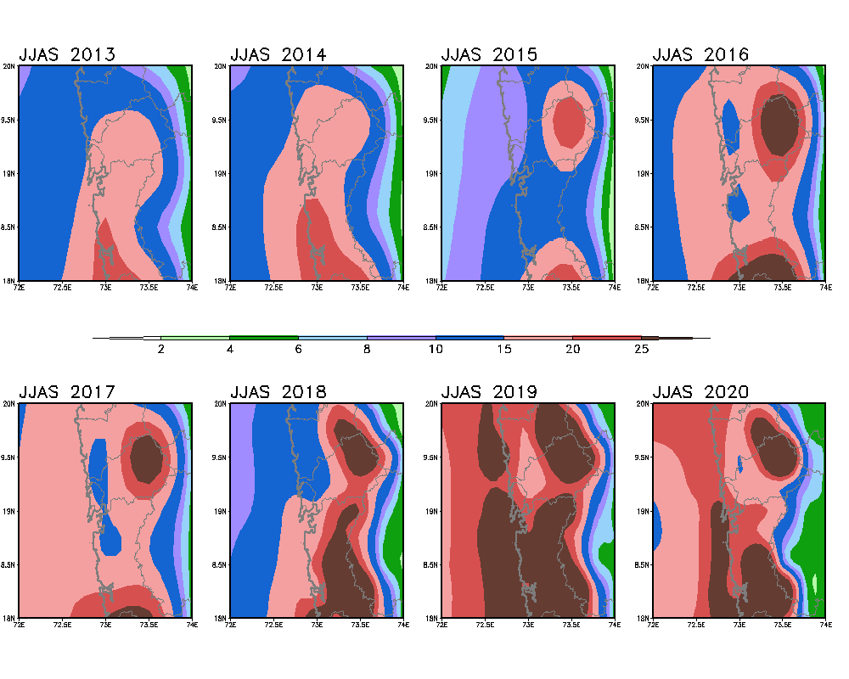
NCUM Day-1 Forecasts Mean JJAS Rainfall (mm/day) over Mumbai

Slide 13
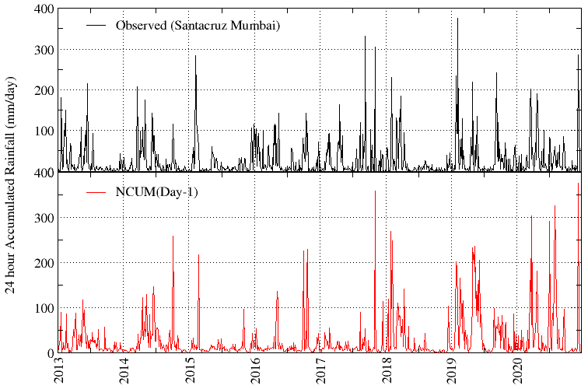
Observed and NCUM Day-1 Forecasts Rainfall (mm/day)
The Day-1 forecasts indicate rainfall > 100 mm/day on several occasions (just a few for >200mm/day)

Slide 14
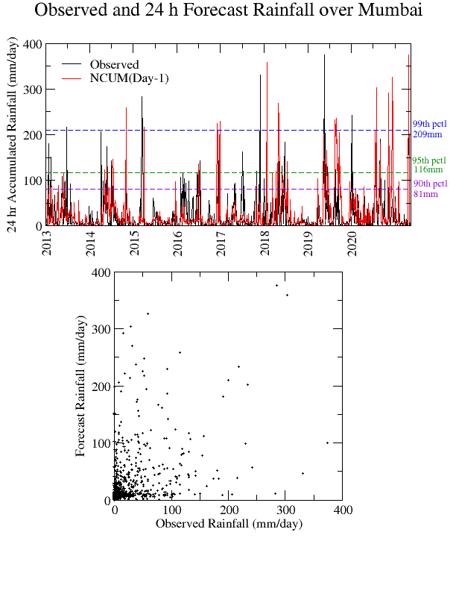
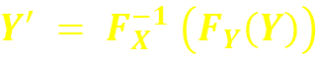
8 seasons x 122 days = 976
Calibration of forecasts can be carried out using empirical cumulative distribution functions (ECDFs)
X – observation/analysis
Y- Raw Model Forecast
Y’- Calibrated Model Forecast
F_{X}- Empirical CDF of Observations
F_{Y}- Empirical CDF of Forecasts

Slide 15
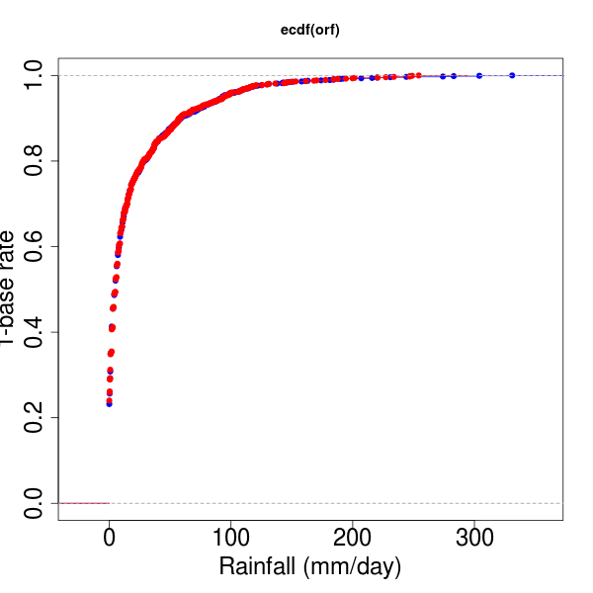
Calibration of forecasts can be carried out using empirical cumulative distribution functions (ECDFs)
X – observation/analysis
Y- Raw Model Forecast
Y’- Calibrated Model Forecast
F_{X}- Empirical CDF of Observations
F_{Y}- Empirical CDF of Forecasts

Slide 16
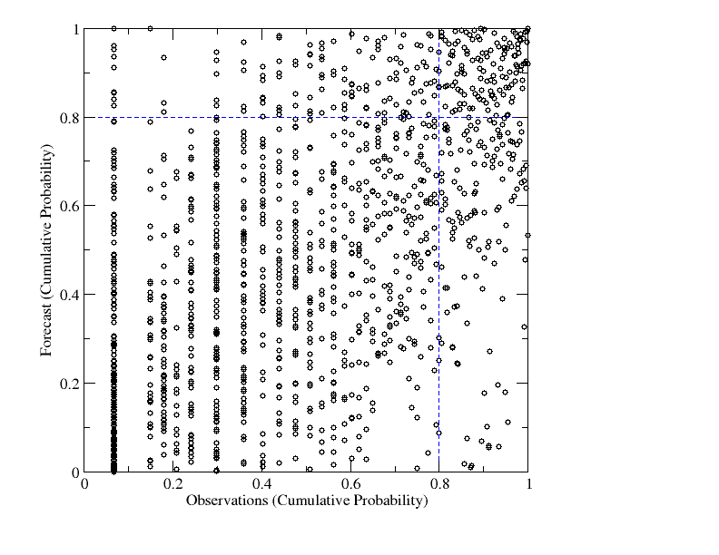
1-p_{y}
1-p_{x}
The scatter shows some positive association at higher thresholds.
Rank based empirical probabilities.
The empirical probability is an estimate of probability Pr (X ≤ x₁) of having a rainfall amount less than observed value x₁.
Hence the probability is largest for extreme rainfall
Some dependency is notable near the extremes (right top corner)

Slide 17
False Alarms
c
a
Hits
Correct Negatives
d
b
Misses

Slide 18
2 x 2 Contingency table for rare/extreme events
Relative frequencies can be written in terms of base rate (p)
H = a/(a+c) Hit rate
B = (a+b)/(a+c) Frequency Bias
F = b/(b+d) False Alarm Rate
p = (a+c)/n Base Rate ; n is the sample size
 | Observed (Y) | Observed (N) | Sum
Forecast (Y) | a | b | (a+b)
Forecast (N) | c | d | (c+d)
Sum | (a+c) | (b+d) | n
Verification Scores degenerate to trivial values as the events become rare since the counts of a, b and c decay to zero at unequal rates (Ferro 2007).

Slide 19
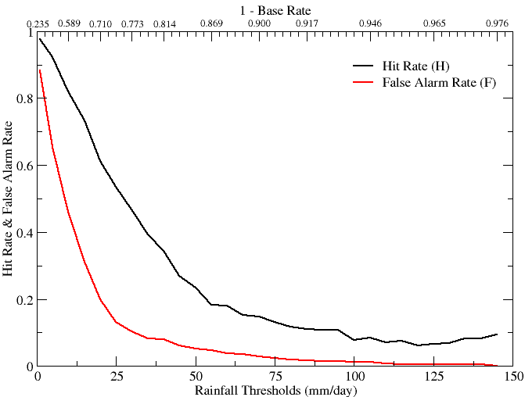
Hit Rate 0 to 1; 1 is perfect
H = a/(a+c)
What fraction of the observed "yes" events were correctly forecast? Ignores false alarms, sensitive to climatology (base rate dependent); good for rate events but can be artificially improved by issuing more “yes” forecasts (sensitive to hedging).
False Alarm rate 0 to 1 ; 0 is perfect
F = b/(b+d)
What fraction of the observed "no" events were incorrectly forecast as "yes"? Ignores mosses, sensitive to false alarms, can be artificially improved by issuing fewer “yes” forecasts
Hit rate (H) for the forecasts decays slowly with increasing rainfall thresholds
False Alarm rate (F) decays at a faster rate
Both F and H approach 0 with decreasing base rate.

Slide 20
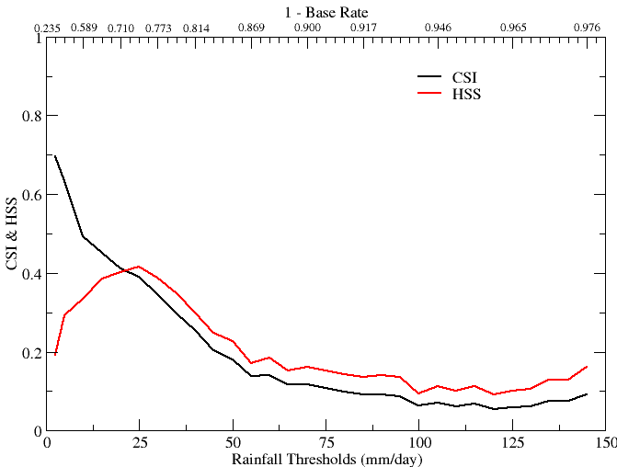
Critical Success Index
0 to 1; 1 is perfect
CSI = a/(a+c+b)
How well did the forecast "yes" events correspond to the observed "yes" events? Sensitive to hits, penalizes both misses and false alarms. Base rate dependent(poorer scores for rarer events) since some hits can occur purely due to random chance.
Heidke Skill Score -1 to 1; 1 is perfect
HSS = [(a+d)-expcr]/n-(expcr)
expcr=(1/n)[(a+c)(a+b)+(d+c)(d+b)
What was the accuracy of the forecast relative to that of random chance? Measures the fraction of correct forecasts after eliminating those forecasts which would be correct due purely to random chance.

Slide 21
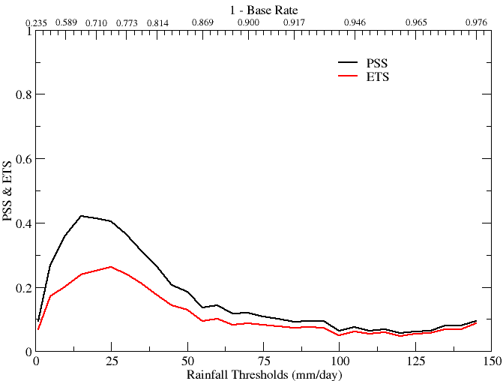
Equitable Threat Score (ETS)
0 to 1; 1 is perfect
ETS = (a-arand)/(a+c+b-arand)
arand=[(a+c)(a+b)]/n
How well did the forecast "yes" events correspond to the observed "yes" events (accounting for hits due to chance)? Sensitive to hits, penalizes both misses and false alarms. Base rate dependent.
Peirce’s Skill Score (PSS)
-1 to 1; 1 is perfect
PSS = H – F
How well did the forecast separate the "yes" events from the "no" events? For rare events HK is unduly weighted toward the first term (same as POD), so this score may be more useful for more frequent events.

Slide 22
verification measures change as we move to rarer events.
hit rate and false-alarm rate decrease toward zero
the odds ratio increases toward infinity as the events become rarer.
This happens because entries a, b, and c in the contingency table tend to decay to zero at unequal rates (Ferro 2007).
Thus, verification of the extreme weather events (high wind speeds, heavy precipitation, or high temperatures etc.,) is a challenge
measures of forecast quality typically degenerate to trivial values as the rarity of the predicted event increases.
growing interest in better ways of verifying forecasts of extreme events.

Slide 23
2 x 2 Contingency table for rare/extreme events
Relative frequencies can be written in terms of base rate (p)
H = a/(a+c) Hit rate
B = (a+b)/(a+c) Frequency Bias
F = b/(b+d) False Alarm Rate ; (B-H)p/(1-p)
p = (a+c)/n Base Rate ; n is the sample size
 | Observed (Y) | Observed (N) | Sum
Forecast (Y) | a=pHn | b=F(1-p)n | (a+b)
Forecast (N) | c=pn(1-H) | d=n(1-F)(1-p) | (c+d)
Sum | (a+c)=pn | (b+d)=(1-p)n | n
p - Base rate; probability of event being observed
All elements are expressed as function of H, F and p.

Slide 24
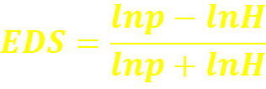
Extreme Dependence Score (EDS)
Where-
p = (a+c)/n is the base rate
H= a/(a+c) is the Hit Rate
Stephenson et al. (2008) proposed a new verification measure, the extreme dependency score or EDS, for summarizing the performance of deterministic forecasts of rare binary events.
EDS converges to a meaningful limit for rare events. For unbiased samples it is a reliable indicator of skill as p 0.
EDS is inequitable and, random forecasts that overpredict occurrence are rewarded by a higher expected score.
An equitable measure assesses the performance relative to a random forecasting system.

Slide 25
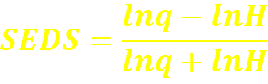
SEDS
Where-
q = (a+b)/n is the frequency at which event is forecast
H= a/(a+c) is the Hit Rate
Hogan et al. (2009) proposed the symmetric extreme dependency score
SEDS can be applied to uncalibrated forecasts while retaining the same desirable properties for verifying rare events
SEDS > EDS if and only if q > p
SEDS = EDS when q = p for recalibrated forecasts.
SEDS is still base-rate dependent, nonregular, and has a range that depends on the base rate (Ferro,2011)

Slide 26
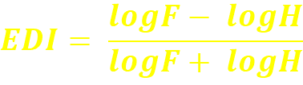
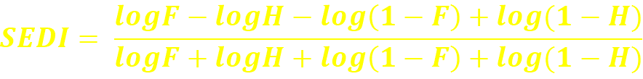
Extremal Dependence Index (EDI) -1 to 1 ; 1 is perfect
What is the association between forecast and observed rare events? Score converge to 2η-1 as event frequency approaches 0, where η is a parameter describing how fast the hit rate converges to zero for rarer events.
Symmertic Extremal Dependence Index (SEDI) -1 to 1 ; 1 is perfect
SEDI shares the same properties as EDI
Including the log(1 - F) and log(1 - H) terms merely makes SEDI complement symmetric. (Ferro,2011)

Slide 27
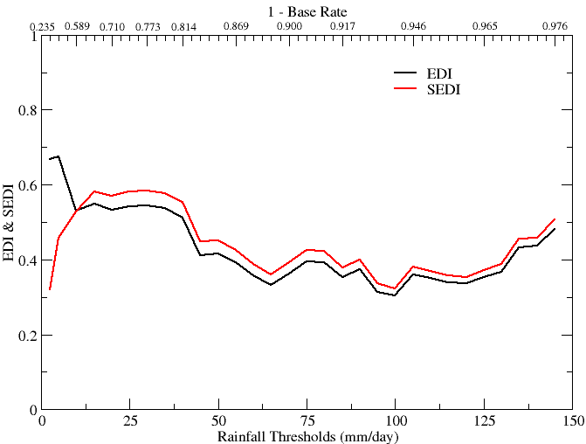
Extremal Dependence Index (EDI) -1 to 1 ; 1 is perfect
Symmertic Extremal Dependence Index (SEDI) -1 to 1 ; 1 is perfect
Both EDI and SEDI ; non-vanishing measures of association
Meaningful values for rate events
Useful measure skill in predicting extreme events

Slide 28
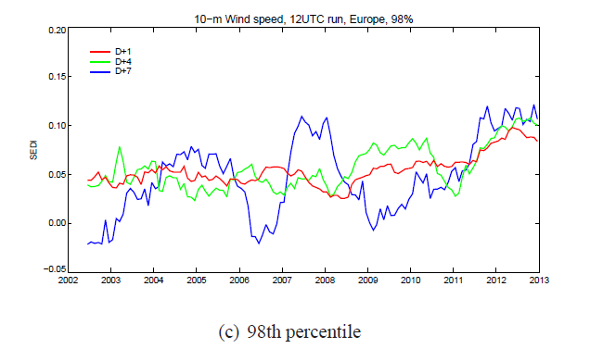

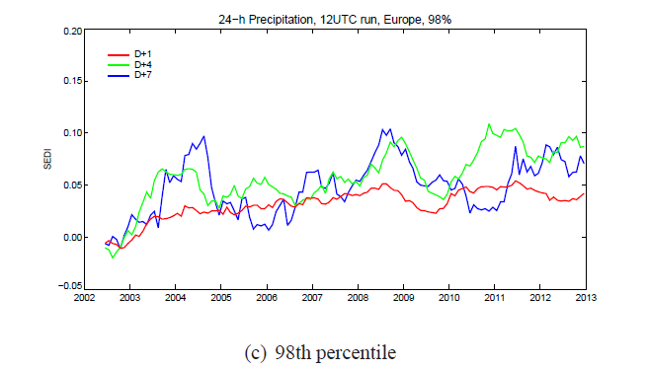
SEDI is now the standard score for monitoring the skill in predicting the extreme events

Slide 29
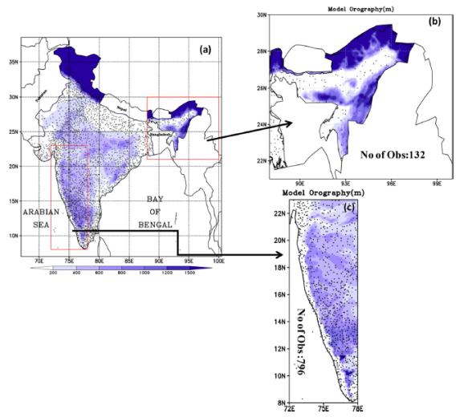
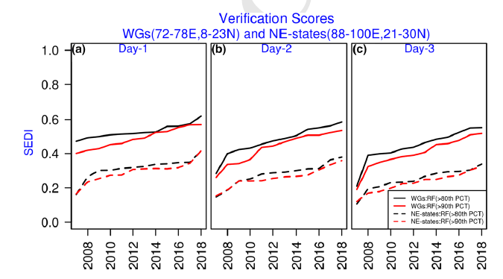
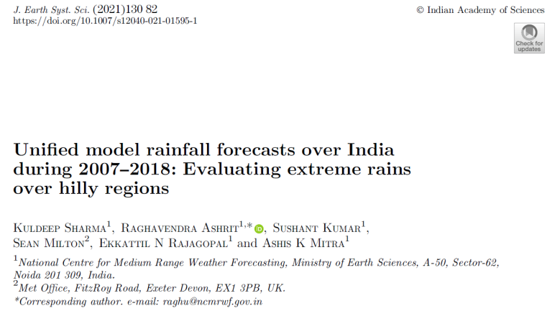
Improved skill in predicting extreme rain in the Met Office rainfall forecasts over Hilly regions of India

Slide 30
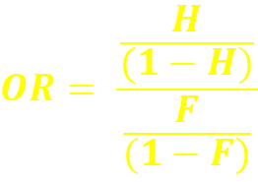
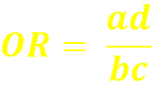
Odds Ratio 0 to ∞, 1 indicates no skill. Perfect score: ∞
What is the ratio of the odds of a "yes" forecast being correct, to the odds of a "yes" forecast being wrong? Measures the ratio of the odds of making a hit to the odds of making a false alarm.
This ratio is greater than one when the hit rate exceeds
the false alarm rate.
The logarithm of the odds ratio is often used instead of the original value. Takes prior probabilities into account.
Gives better scores for rarer events.
Less sensitive to hedging.
Do not use if any of the cells in the contingency table are equal to 0.
Log odds ratio : -∞ to ∞, 0 indicates no skill. Perfect score: ∞

Slide 31
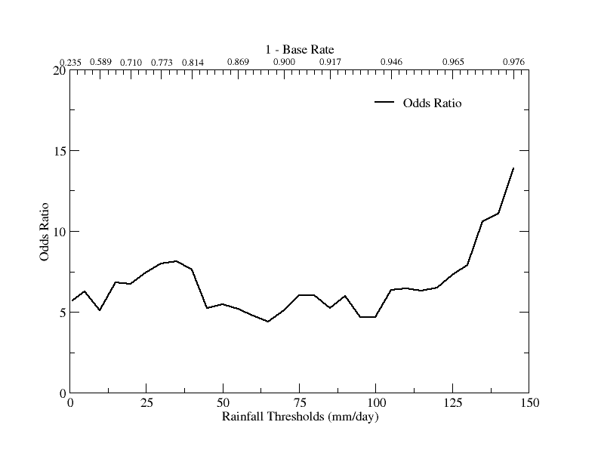
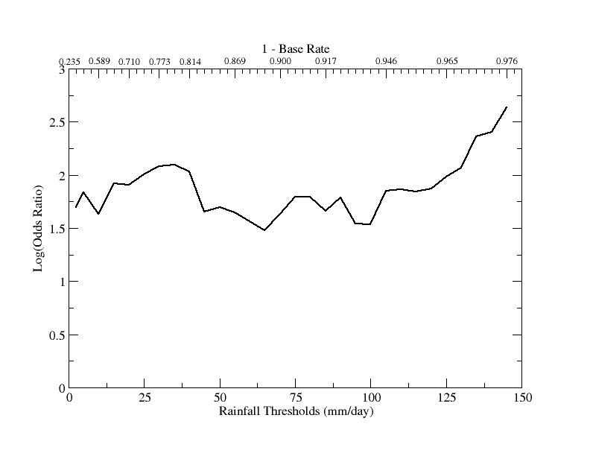

Slide 32
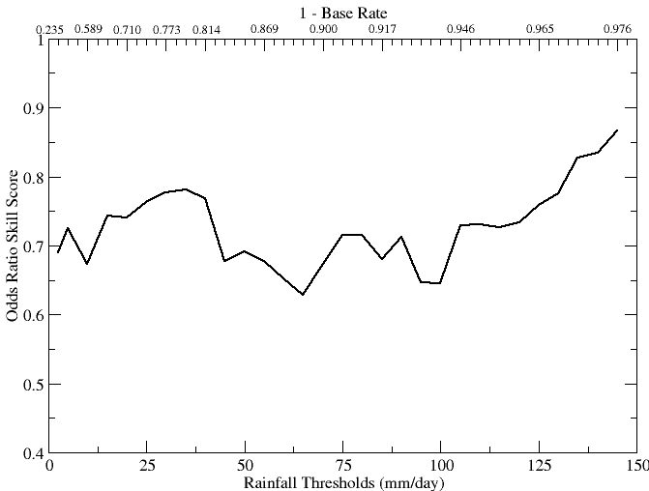
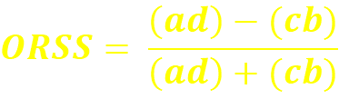
Odds Ratio Skill Score
-1 to 1, 0 indicates no skill. Perfect score: 1
What was the improvement of the forecast over random chance?

Slide 33
References:
Jolliffe, I.T., and D.B. Stephenson, 2012: Forecast Verification: A Practitioner's Guide in Atmospheric Science. 2nd Edition. Wiley and Sons Ltd, 274 pp.
Stephenson D.B., B. Casati, C.A.T. Ferro and C.A. Wilson, 2008: The extreme dependency score: a non-vanishing measure for forecasts of rare events. Meteorol. Appl., 15, 41-50.
Ferro C.A.T., 2007: A probability model for verifying deterministic forecasts of extreme events. Wea. Forecasting, 22, 1089-1100.
Ferro C.A.T., and D.B. Stephenson, 2011: Extremal Dependence Indices: improved verification measures for deterministic forecasts of rare binary events. Wea. Forecasting, 26, 699-713.
Stephenson, D.B., 2000: Use of the "odds ratio" for diagnosing forecast skill. Wea. Forecasting, 15, 221-232.

Slide 34
Summary
Which scores are the best for rare event forecasts?
EDS, Odds ratio, … (PSS,HSS,ETS!0!)
Can rare event scores be improved by hedging?
Yes (so be very careful when using them!)
How much true skill is there in forecasts of extreme events?
Quite a bit!
Are extreme events easier to forecast than small magnitude events? skill!0?
Perhaps yes – there is extreme dependency

Slide 35
Verification of Tropical Cyclone (Track and Intensity forecasts)

Slide 36
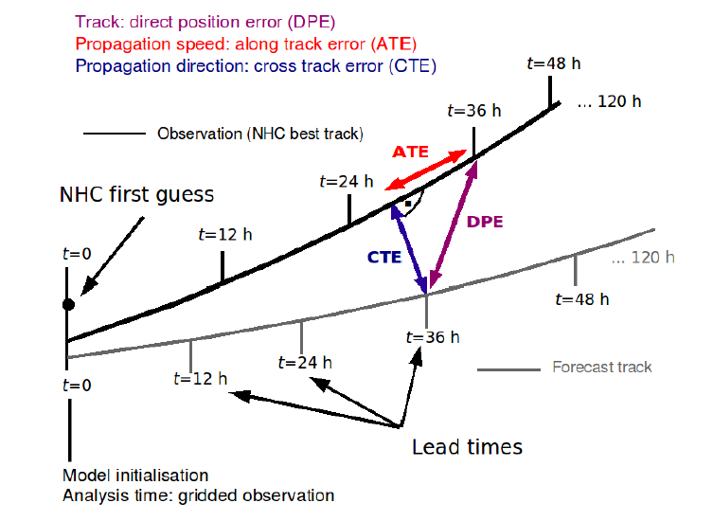
Observed and Forecast Tracks of Tropical Cyclones

Slide 37
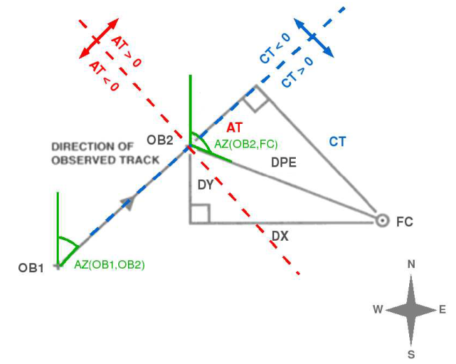
Track and storm center verification
Forecast track error is defined as the great-circle difference between
TC’s forecast center position
best-track position at the verification time (VT).
It is vector quantity, which can be decomposed into components of -
Along-track errors (ATE) : whether model is moving a storm faster or slower,
Cross-track error (CTE) : displacement to the right or left of the observed track.
The two components can also be interpreted as errors in where the TC is heading (cross-track) and when it will arrive (along-track).

Slide 38
Direct Position Error (DPE)
The DPE is calculated based on this formula:
This is the great circle distance between (°) the observed position (O) and forecast position (F)
X= longitudes
Y=latitudes

Slide 39
Direct Position Error (DPE)
DPE can give a basic indication of the track forecast error in the model forecast.
DPE value alone may not always indicate the skill of the model in forecasting a TC:
In some regions TC tracks are more predictable than in others
TCs which take a "straight-running" track are easier to forecast than those which take more complex tracks.

Slide 40
Cross Track Error (CTE)
CTE is the component of the error perpendicular to the observed track.
It is calculated by extrapolating the line joining the observed position at the verifying time and the observed position 6 hours earlier and identifying the point where this is intersected at right-angles by a line drawn from the forecast position at the VT.
Extrapolating the line OB1-OB2
Finding the intersection point at right angel with line from FC
Slopes of intersecting lines at 90° ; m1*m2=-1 is used to estimate intersection point

Slide 41
Cross Track Error (CTE)
CTE is +ve : the forecast position is to the right (left) of observed track in NH (SH)
CTE is -ve : the forecast position is to the left (right) of observed track in NH (SH)
For a TC moving from east to west (i.e. has not yet recurved), a positive CTE would indicate that the model had a polewards bias in its forecast track.

Slide 42
Along Track Error (ATE)
ATE is the component of the error along the observed track.
ATE is computed from DPE and CTE.
ATE is +ve : if the point of intersection lies ahead of the observed position at the VT
A positive (negative) ATE would indicate that the model has a fast (slow) bias in its forecast track

Slide 43
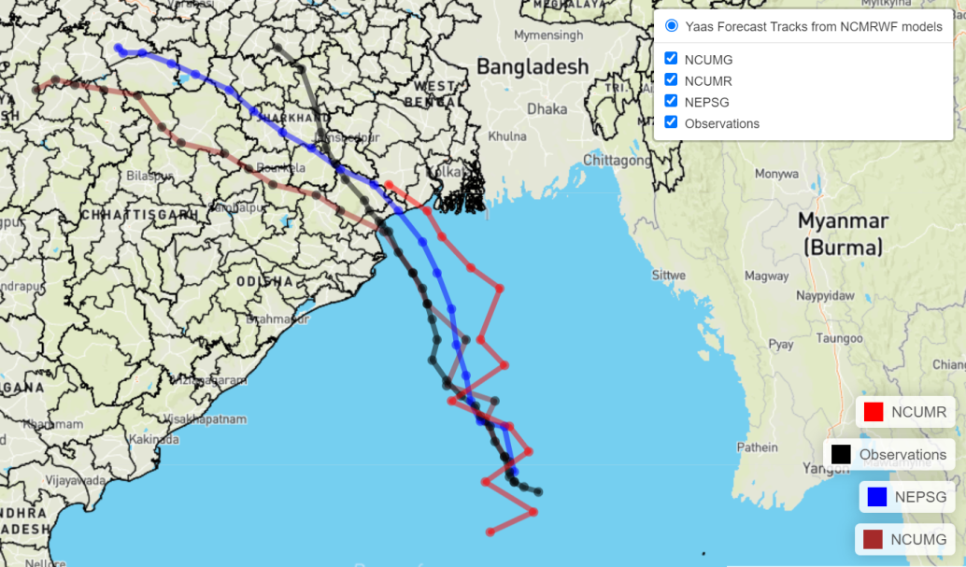
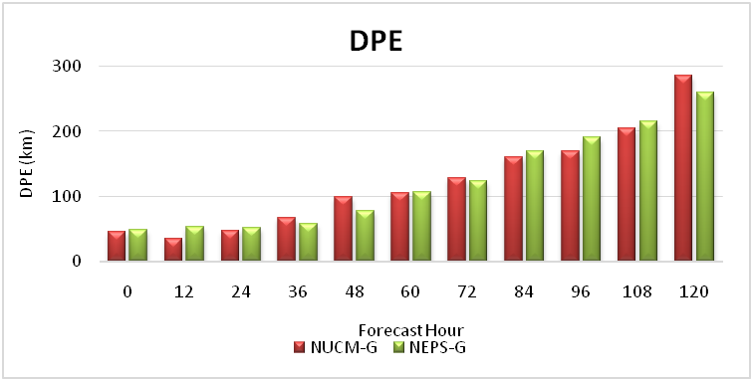
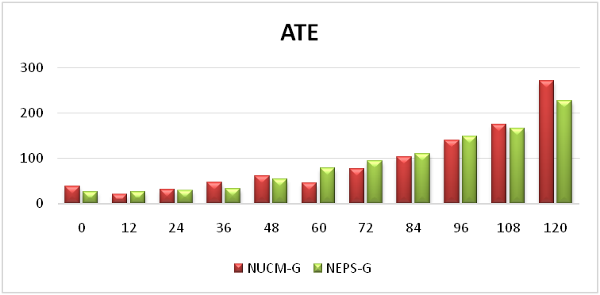
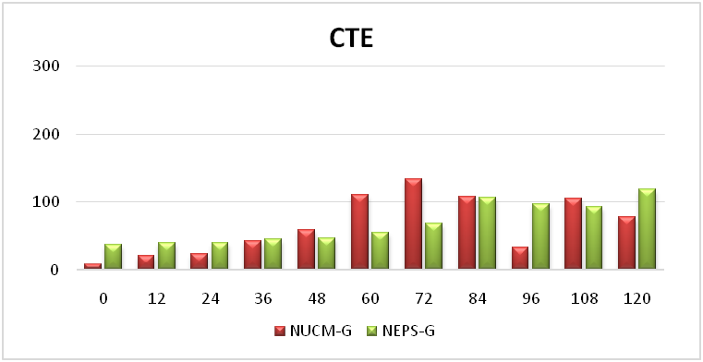
Observed and forecast tracks of Taukte based on 00UTC on 24th May 2021
Model/Fcst hr | 0 | 12 | 24 | 36 | 48 | 60 | 72 | 84 | 96 | 108 | 120
NCUMG | 46 | 34 | 47 | 66 | 99 | 106 | 129 | 161 | 169 | 205 | 286
 | 9 | 8 | 8 | 8 | 9 | 8 | 7 | 7 | 7 | 6 | 5
NEPSG | 48 | 53 | 51 | 58 | 78 | 106 | 124 | 169 | 190 | 216 | 260
 | 5 | 8 | 9 | 9 | 10 | 9 | 8 | 7 | 6 | 5 | 4

Slide 44
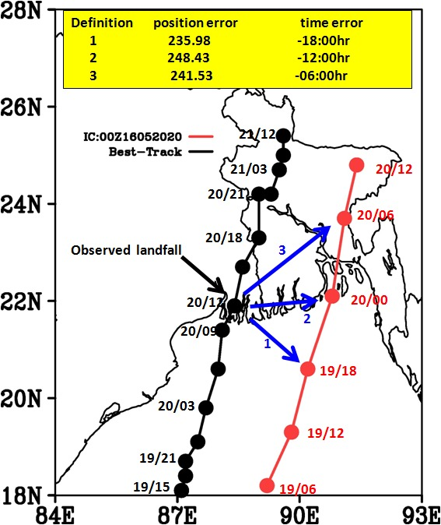
Landfall Errors
Landfall is defined as the time and location at which the storm center crosses the coastline
TC landfall location and timing can be evaluated using standard verification measures and approaches for deterministic variables.

Slide 45
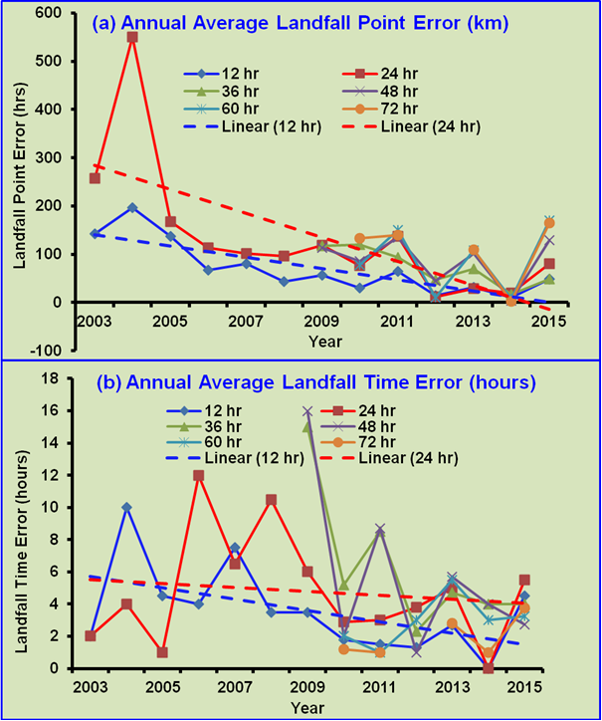
Souce: www.imd.gov.in

Slide 46
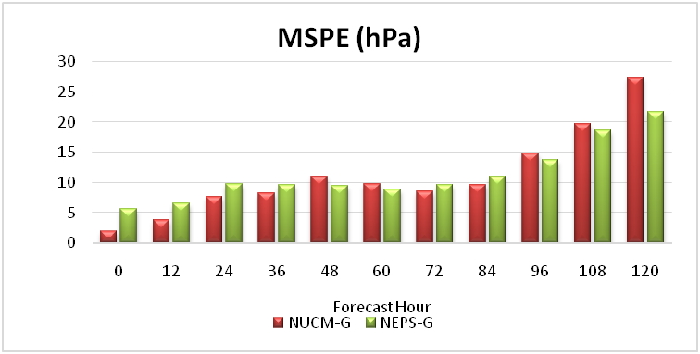
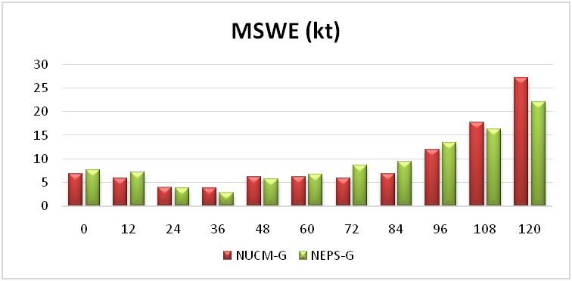
TC Intensity
mean absolute error in minimum sea level pressure (MSPE in hPa)
Mean absolute error in maximum sustained winds(MSWE in kt)

Slide 47
TC Intensity
Traditional approaches to evaluating TC track and intensity ignores possible “misses” and “false alarms” that might be associated with the forecasts.
Models may produce TCs that do not exist in the Best Track data (e.g., that are projected to continue to exist after the actual storm has dissipated) and should be counted as false alarms.
And it is possible that a storm can be projected to weaken and dissipate at a time that is earlier than the actual time of dissipation; in this case, a “miss” should be counted.
For such cases a contingency table should be constructed with different combinations of forecast and observed intensity
Including cells for situations when either the forecast storm and/or the observed storm dissipated.

Slide 48
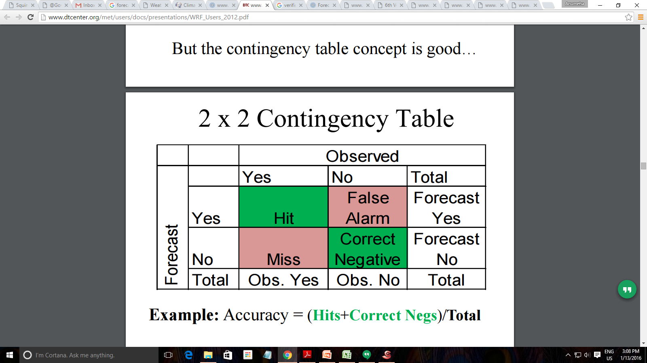
TC Intensity tendency
From this statistics like FAR and POD could be computed to measure the impact of false alarms and misses;
Forecasters are concerned about rapid changes in intensity – either increasing or weakening.
Typically this characteristic is measured by setting a threshold for a change in intensity over a 24h period. Normally this variable is treated as a Yes/No phenomenon (i.e., either the rapid change occurred or it did not occur, and it either was or was not forecast).
In that case, basic categorical verification approaches can be applied to compute statistics such as probability of detection (POD) and false alarm ratio (FAR).

Slide 49
TC Intensity tendency
NWP model predictions of intensity tendency :
Forecast change in intensity in successive lead times
Observed change in intensity
It is a Hit when
Model predicted strengthening (weakening) between two successive time steps
observations showed strengthening (weakening)
It is a Miss when
the model’s forecast tendency was opposite to that in the observations
Having established the numbers of ‘hits’ and ‘misses’, it is possible to calculate a hit rate and skill score relative to chance:
Hit Rate (%) = 100 x [hits / (hits + misses)]

Slide 50
Intensity Tendency Skill Score
ITSS (%) = (Hit Rate – 0.50) x 2
Example 1:
Hits = 80
Misses = 20
Hit rate = 80/(80+20) = 0.80
ITSS = (0.80-0.50)*2 = 0.60
Model scored 60% more hits than chance (=50 out of 100)
Example 2:
Hits = 40
Misses = 60
Hit Rate = 0.40
ITSS = -0.20
Model is worst than by chance
Thus if the ITSS>0, forecast shows some skill in forecasting intensity tendency.
The ITSS can have any value from -100% to +100%.

Slide 51
References
WMO. 2013. Verification Methods for Tropical Cyclone Forecasts. WWRP/WGNE Joint Working Group on Forecast Verification Research, WWRP 2013-7. World Meteorological Organization: Geneva, Switzerland.
Heming, J. T. 2017: Tropical cyclone tracking and verification techniques for Met Office numerical weather prediction models., Meteorol. Appl. 24: 1–8, DOI: 10.1002/met.1599

Slide 52
Summary
Track forecast verification
DPE, ATE and CTE, landfall position and time error
Intensity Forecast verification
MAE in Min SLP and Max Wind
Intensity Tendency Skill Score

